Slide 1
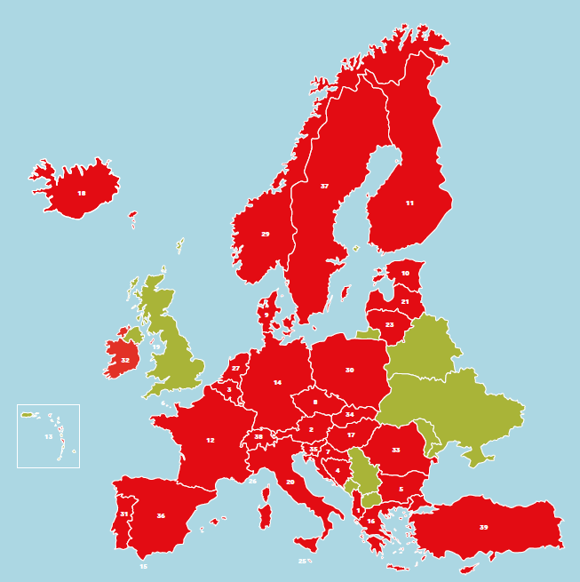
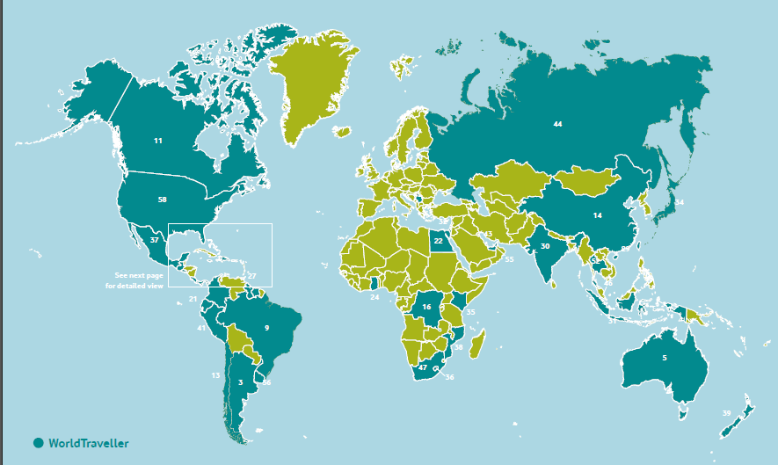
Life, Uninterrupted – what have we launched?
Vodafone Global Roaming
Vodafone has made roaming whilst on holiday even simpler with the launch of Vodafone Global Roaming. From today, all new and upgrading pay monthly customers will be able to take their home plan abroad to 100 destinations, more than any other UK network. We also offer the most 4G roaming destinations and we don’t throttle data unlike some competitors.
Roam-free
Take your full home plan abroad to
40 destinations
Vodafone Global Roaming overview
Full home plan of texts, minutes & data can be used across 100 destinations
40 Roam free destinations at no additional cost
60 Roam Further destinations for just £5 a day
More 4G destinations than any other operator (117 destinations worldwide)
No data throttling
For a full breakdown of Roam Free & Roam Further destinations, visit Vodafone.co.uk/Roaming
Roam-further
Take your full home plan abroad to over 60 Roam Further destinations for just £5 per day
Vodafone is the first UK operator to completely abolish EU roaming charges on Pay monthly plans
Take your pay monthly plan abroad with Vodafone – The UK’s best roaming network
Vodafone Flexi-upgrades and simpler plans
Flexi-upgrades has been introduced so that pay monthly handset & tablet customers don’t have to wait the full 24 months to get their hands on the latest devices. All they have to do is pay a Flexi-upgrade fee after six months to upgrade a phone of their choice. We’ve also introduced simpler plans which come with larger data allowances giving our customers more of what they love!
Vodafone Flexi-upgrades
New, simpler plans
Customers now don’t have to wait 24 months to get their hands on the newest handsets and tablets.
They can Flexi-upgrade after 6 months of their current pay monthly contract
Trade in cash can also be used to pay off the balance left on their current plan, freeing them up to grab that new device, whenever they want.
We’ve simplified our pay monthly plans into three simple, no-nonsense plans:
Essentials includes unlimited texts, 500 minutes and up to 500MB of data;
Red Extra provides a generous up to 40GB of data on top of unlimited calls and texts.
Red Entertainment plans now come with up to 60GB of 4G data as well as a choice of entertainment
Keep up to date with all the latest news from Vodafone UK at https://mediacentre.vodafone.co.uk/ If you have a specific query contact the media relations on 01635 693693

